Slide 1

Insights of Movies Productions
For ABC Production Ltd.
by Anurag Sarkar
(Consultant, XYZ Private Limited)

Slide 2

Introduction
This Exploratory Data Analysis is based on a dataset of 1000 movies, focusing on various attributes such as genre, release year, ratings, and revenue. The goal is to extract actionable insights that could inform decision-making processes in the film industry.

Slide 3
Problem Statement
ABC Movie Production Company approaches XYZ agency in the beginning of year 2017
ABC’s Aim: Produce Movies that earn highest Revenue, Rating and Critical Acclaim.
ABC’s Need: Find out characteristics of movies that earn highest Revenue, Rating and Critical Acclaim
ABC also wants to know:
Movie Industry Growth ?
Right time to invest in the Movie Industry ?

Slide 4
Background
IMDB (Internet Movie Database): Popular online database for movies, television programs etc.
IMDB Registered users: Rate movies on a scale of 1 to 10.
IMDB Rating: Weighted-Mean Rating displayed beside each movie title.
Metascore: IMDB also displays rating from metacritic.com
IMDB Most Popular 1000 movies from 2006-2016 would be ideal to find insights for ABC’s need.

Slide 5
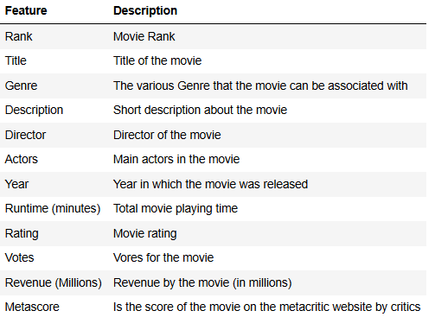
Data Description

Slide 6
Data in Deep
Consists of 1000 rows (movies) and 12 columns (Rank, Title, Rating etc)
% of missing values in columns: Revenue – 13%, Metascore - 6%
Filled missing values in columns:
Revenue – by Median Revenue
Metascore – by Mean Metascore.
After imputation: 1000 rows and 12 columns
There is no incorrect datatypes.
The relationship of Genre, Director, Runtime of movies against Revenue, Rating and Metascore could provide significant insights.

Slide 7
What did I do ?
Examined the dataset
Cleaned up the dataset
Came up with several questions to find out the relationship of Genre, Director and Runtime of movies against Revenue, Rating and Metascore.
Explored the dataset based on the questions using descriptive statistics and visualization.
Drew conclusions from the exploration.
Found out actionable insights from conclusion.

Slide 8
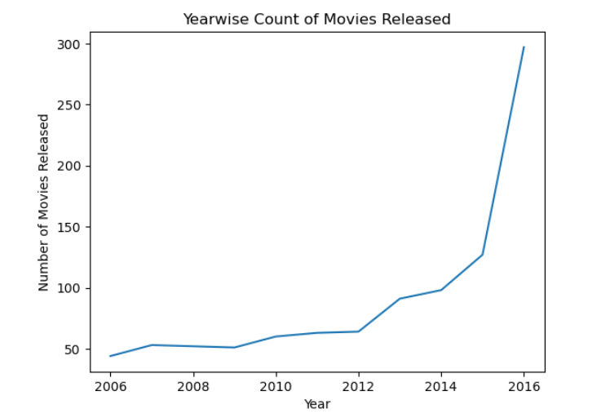
Growth of Industry
So, the trend is very clear. In last 10 years, the number of movies released grew up gradually from 2006 to 2012 & then we can see a sudden rise. Specifically, after 2015 there was a huge growth in this case.

Slide 9
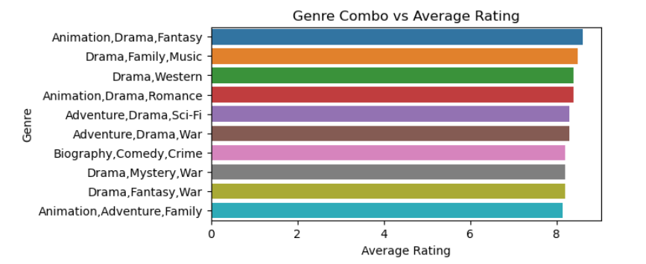
Popular Genre (Audience)
Animation, Drama & Fantasy is the most popular combo of genres among the audience

Slide 10
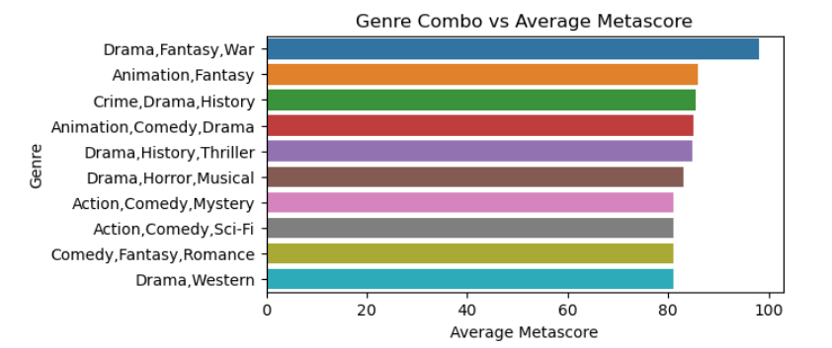
Popular Genre (Critics)
Drama, Fantasy & War is the most popular combo of genres among the audience

Slide 11
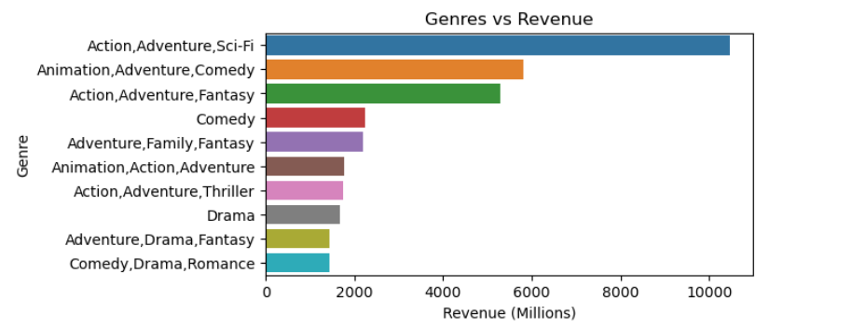
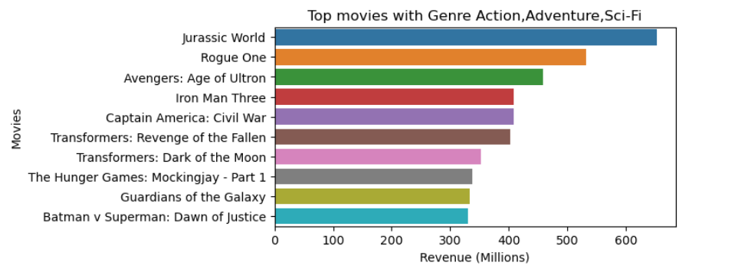
Genre to Generates Highest Revenue
Action, Adventure & SciFi generates highest revenue with Jurassic World contributed most followed by Rouge One & Avengers: Age of Ultron

Slide 12
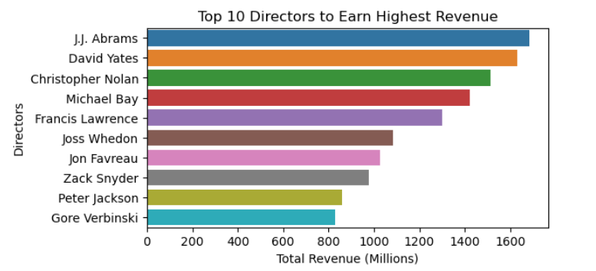
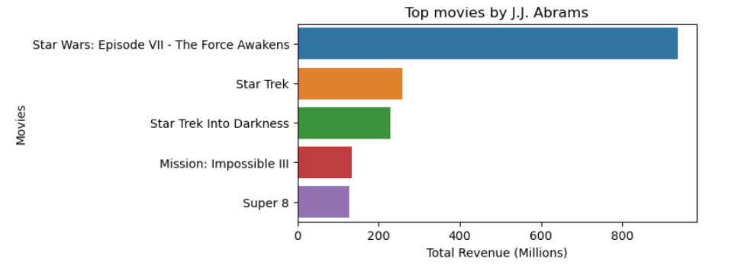
Director & Revenue
J.J. Abrams is the director who earned the most revenue over last 10 year. Among his movies, Star Wars: Episode VII - The Force Awakens generated most

Slide 13
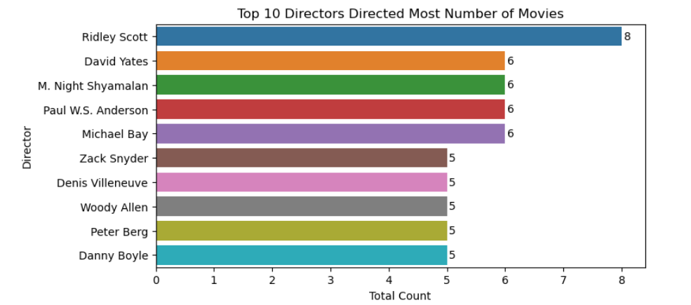
Top 10 Directors with Most Number of Movies
Ridley Scott is the director who directed most number of movies over the years followed by David Yates.

Slide 14
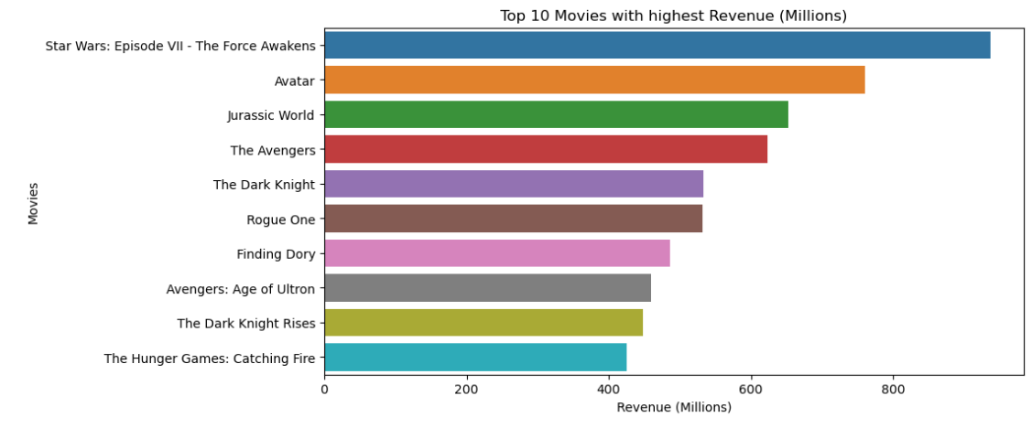
Top 10 Movies by Total Revenue

Slide 15
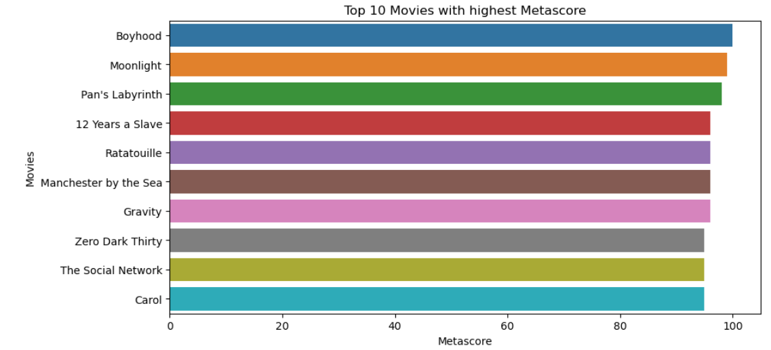
Top 10 Movies by Critics

Slide 16
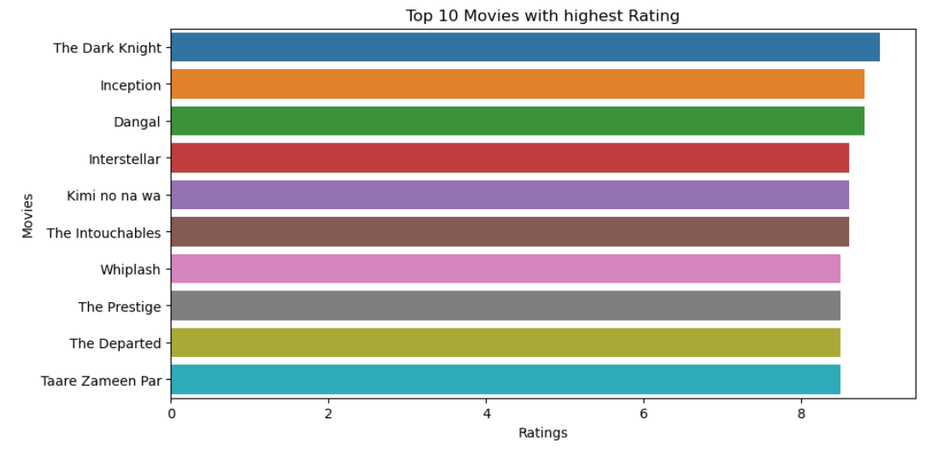
Top 10 Movies by Audience

Slide 17
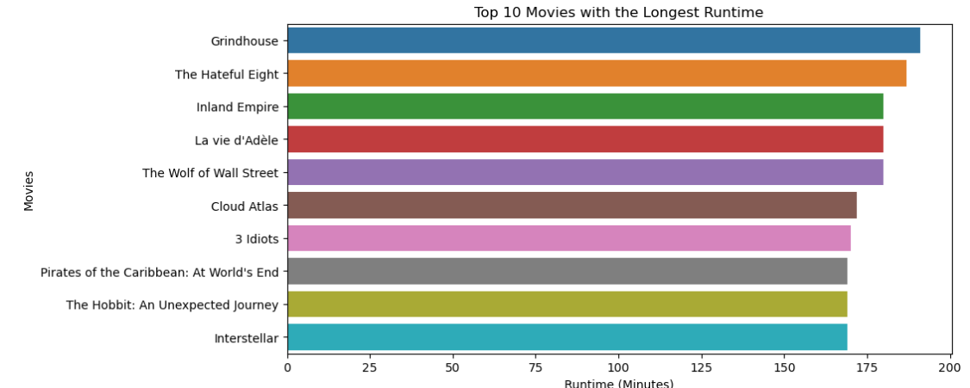
Top 10 Movies with Longest Run Time

Slide 18
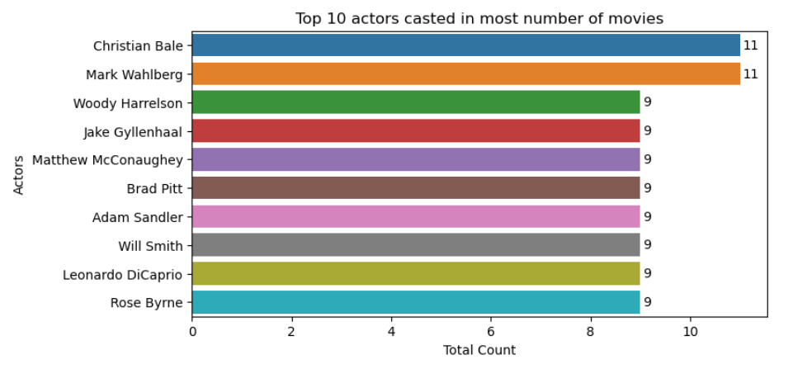
Actors Featured in Most Number of Movies

Slide 19
Conclusion
As per the trend the industry is growing day by day, it is not a good idea to bring one movie per year to the audience. The whole scenario will be profitable with bunch of movies per year with best features. Best features are,
1. Genre : Since 'Drama' is the most popular genre, so production company can invest on this genre. More specifically, in the combo of genres like 'Action - Adventure - SciFi'.
2. Director : The production should target the directors whose movies generated higher revenue. For example - J.J. Abrams, David Yates, Christopher Nolan.
3. Actors : The production company should work with the artist/group of artist who are featured in more movies.
4. Customer Satisfaction : For the customer satisfaction, production company should focus more on the genres which are generating higher revenue and getting higher ratings from audiance.

Slide 20
THANKS
By ANURAG SARKAR (sarkaranurag73@outlook.com)

